Slide 1

Evaluation with AI

Slide 2
Evaluation with AI
Presented By:-
Sumit Upadhyay: 23WU0101167
V.Monishwar Reddy: 23WU0101185
Varad Patil: 23WU0101184
Yashvardhan Sachan: 23WU0101196
Satwik: 23WU0101152
Supervised by:- Meher Gayatri Devi Tiwari,
Assistant Professor

Slide 3
Introduction
Objective: In today's academic and professional environments, the assessment of handwritten documents, essays, and assignments often consumes valuable time and resources. Evaluators face challenges, including fatigue and potential biases, while plagiarism detection is a time-consuming task. Our project aims to address these challenges using AI/ML technologies.
The goal is to create an AI/ML system for:
Handwriting recognition
Plagiarism detection
Identifying AI-written text
Automating evaluation and grading

Slide 4
Libraries
To build our AI-powered system, we utilized a set of robust libraries and tools. Each one plays a unique role in ensuring the functionality and efficiency of our solution. Next slides consists of the key libraries we used:

Slide 5
NumPy
Efficient data handling is crucial for feeding the model, and that's where NumPy comes in. It allows us to perform numerical operations on arrays and matrices, optimizing our data for neural network input by reshaping and normalizing the pixel values of the handwritten images.
Key Features:
Performance: High-speed processing of multi-dimensional arrays, allowing us to handle large datasets efficiently.
Mathematical Operations: Performs complex operations like normalization and reshaping in a few lines of code.
Interoperability: Seamlessly integrates with other libraries, making it essential for machine learning pipelines.

Slide 6
Pandas
Managing data efficiently is crucial for any machine learning project. Pandas allows us to load and process our CSV dataset of handwriting samples quickly. By converting the dataset into a manageable structure, we can filter, clean, and prepare it for the model.
Key Features:
Data Manipulation: Offers powerful tools for cleaning, transforming, and analyzing large datasets.
Data Transformation: Converts raw CSV files into a structured format that’s ready for machine learning processing.
Efficient Handling: Handles millions of rows of data with minimal memory usage.

Slide 7
Handwriting Recognition with TensorFlow
When building a model to recognize handwritten alphabets, TensorFlow is the backbone. This open-source machine learning library gives us the ability to create, train, and fine-tune deep learning models with ease. TensorFlow allows us to build complex neural networks that learn patterns from the data to make predictions on unseen handwriting.
Key Features:
Scalability: Allows us to scale our model for larger datasets without significant changes to the code.
Flexibility: Supports both high-level operations and low-level mathematical functions, giving us full control over model training.
Deployment: Enables us to deploy the trained models across multiple platforms, from web applications to mobile devices.

Slide 8
Matplotlib
To better understand the distribution of our dataset and visualize predictions, we use Matplotlib. This library is instrumental in creating graphical representations of the alphabet data, which helps in analyzing patterns and anomalies before and after training the model.
Key Features:
Visualization: Creates detailed graphs and charts that help us interpret data at various stages of the project.
Customizability: Highly customizable for generating specific visual outputs like bar charts and sample image grids.
Ease of Use: Simple syntax makes it easy to quickly visualize any aspect of the data or model performance.

Slide 9
OpenCV
Recognizing handwriting requires preprocessing images effectively. OpenCV enables us to prepare the handwriting images for analysis by isolating characters, applying filters, and enhancing the image quality before feeding it into our model for prediction.
Key Features:
Image Processing: Provides advanced image filtering techniques to sharpen and clean input images.
Contour Detection: Helps in detecting and extracting individual characters from images for better model accuracy.
Preprocessing: Prepares images for the neural network by resizing and standardizing them for consistent input.

Slide 10
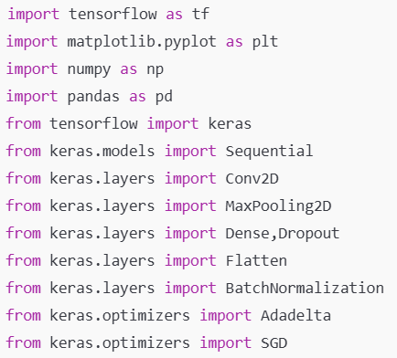
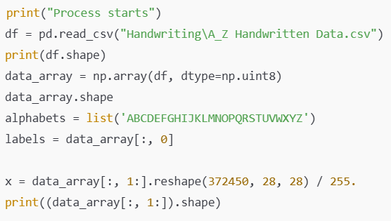
Code
Importing Libraries
Loading and Pre-processing Data

Slide 11
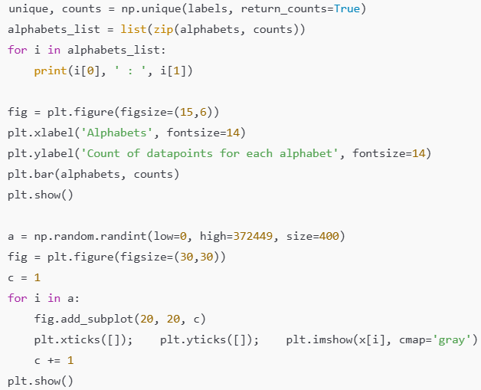
Code
Visualizing Alphabet Distribution and Sample Images
Building, Compiling, and Training the CNN Model
We build a Convolutional Neural Network (CNN), which is like giving our computer the ability to "see" the images and recognize patterns. We train this model on the dataset, where it learns to identify the differences between letters based on the input images. We’re using a well-tested learning process to make our model smarter with each step.

Slide 12
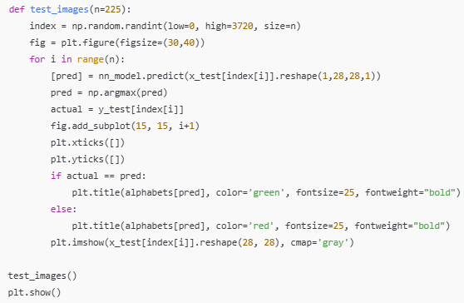
Code
Testing the Model on New Images
Unseen Data Testing (External Image)
we feed the model some entirely new handwritten text that it hasn’t seen before. We process this new image, isolate individual letters, and let the model predict them. By this way, the model can be applied to real-world scenarios, such as recognizing handwritten notes!

Slide 13
Conclusion
Through the use of advanced AI/ML technologies, we have developed a comprehensive system capable of automating handwriting recognition, plagiarism detection, and assignment evaluation. This system not only streamlines the assessment process but also ensures fairness and integrity in academic settings.
Key Achievements:
Reduced the time and effort required for grading handwritten submissions.
Improved the accuracy and fairness of grading through AI.
Provided a reliable method for detecting plagiarism and AI-written content.

